Slide 1
INTERPOLATION
CHAPTER 3

Slide 2
INTRODUCTION
Interpolation is the process of deriving a simple function from a set of discrete data points so that the function passes through all the given data points (i.e. reproduces the data points exactly) and can be used to estimate data points in-between the given ones.

Slide 3
BASIC PRINCIPLE IN INTERPOLATION
Interpolation is the procedure of estimating the value of properties at unsampled points or areas using a limited number of sampled observations.
In case a single function of the curve or surface fitting is determined, the interpolation is called global interpolation, and in case different functions are adopted locally and repeatedly in a small portion of the total area, it is called local interpolation.
When curve or surface fitting is executed with all the sampled observations, the interpolation is called exact interpolation, where as in case the fitted curve or surface does not pass through all the sampled observations because of some expected errors, it is called approximate interpolation.
Approximate interpolation is sometimes used in spatial prediction of trend or representation of grid cells or unit areas.

Slide 4
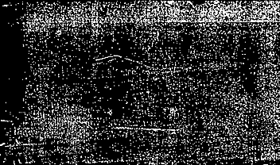
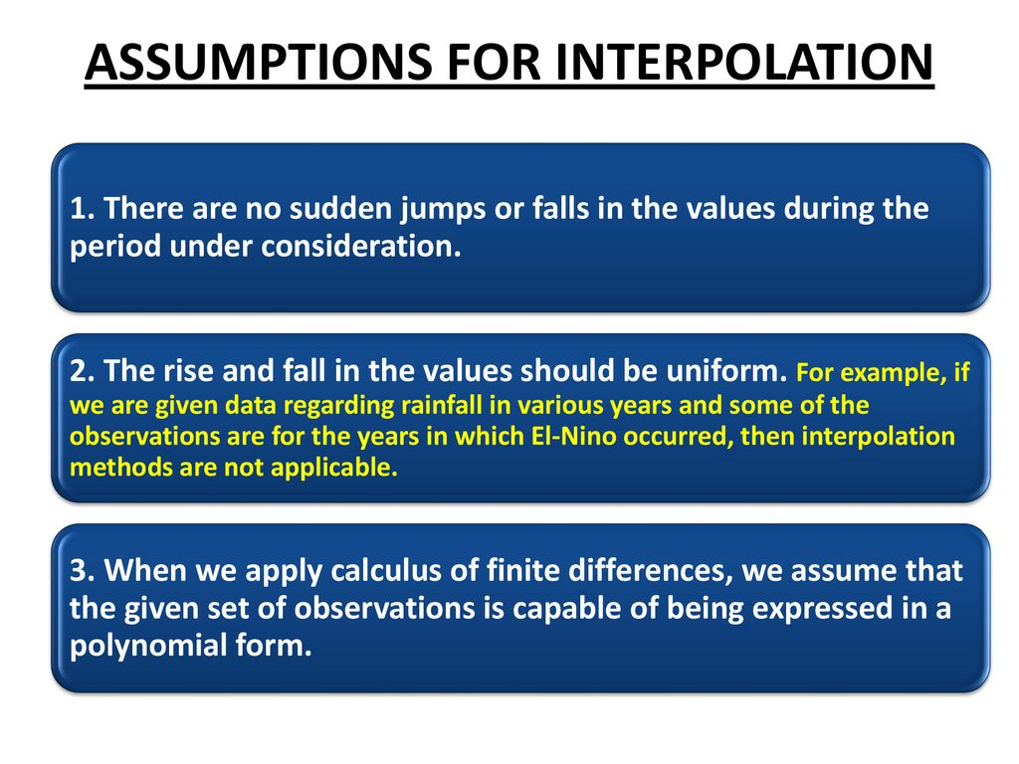
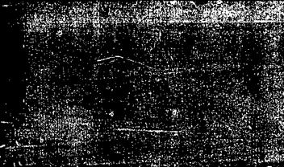
FUNDAMENTAL ASSUMPTIONS IN INTERPOLATION

Slide 5



The forward difference is a finite difference defined by
Higher order differences are obtained by repeated operations of the forward difference operator,

Slide 6
Backward Differences.
The value a = 0 gives x = x₀; a=1 gives x = x₁. This approximation uses the points to the left of the point x₀, and fits a polynomial through two or more points. Keeping only the first two terms gives a straight line through the points x₀ and x₁.
CENTRAL DIFFERENCE
consider a linear interpolation between the past data value (t₋₁,I₋₁) and the future data value (t₁,I₁). The slope of the secant line between these two points approximates the derivative by the central (three-point) difference:
I'(t₀) = (I₁-I₋₁) / (t₁ - t₋₁)

Slide 7
If the data values are equally spaced, the central difference is an average of the forward and backward differences. The truncation error of the central difference approximation is order of O(h²), where h is the step size. It is clear that the central difference gives a much more accurate approximation of the derivative compared to the forward and backward differences. Central differences are useful in solving partial differential equations. If the data values are available both in the past and in the future, the numerical derivative should be approximated by the central difference.

Slide 8

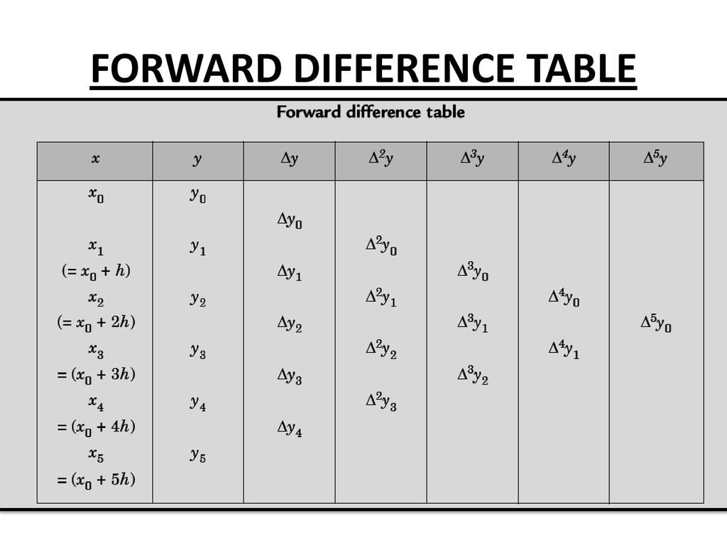

Slide 9
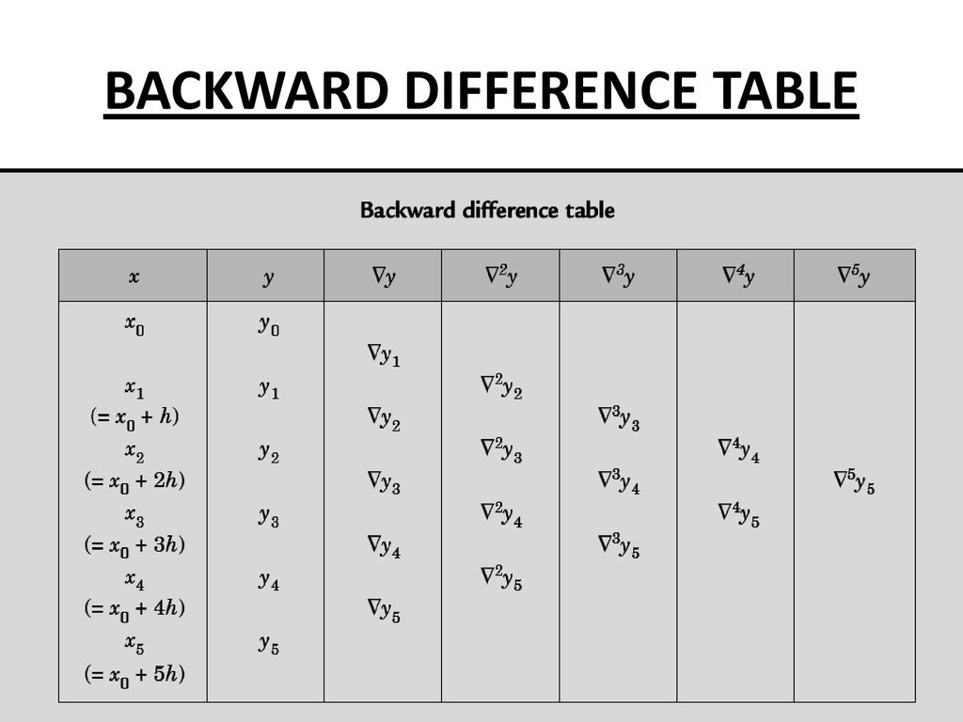

Slide 10
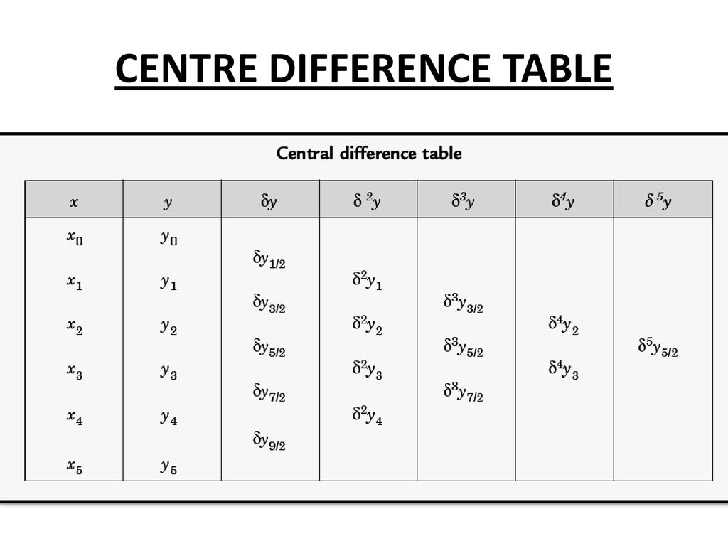

Slide 11
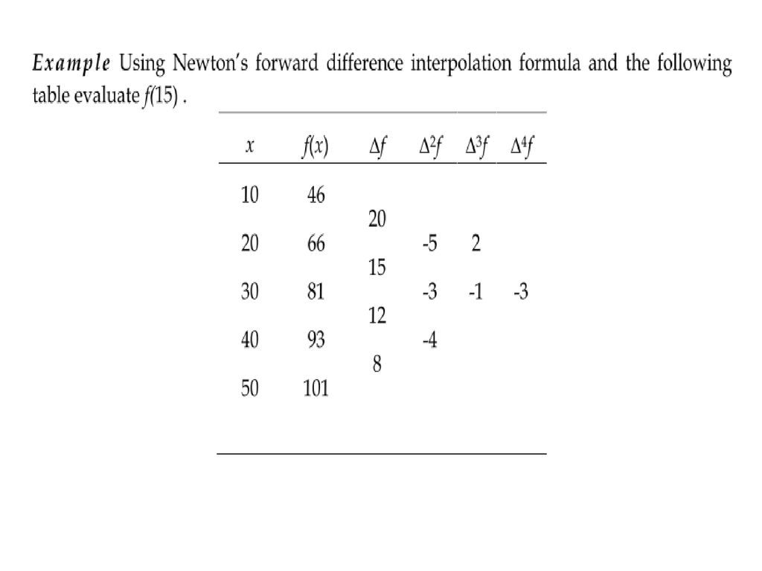

Slide 12
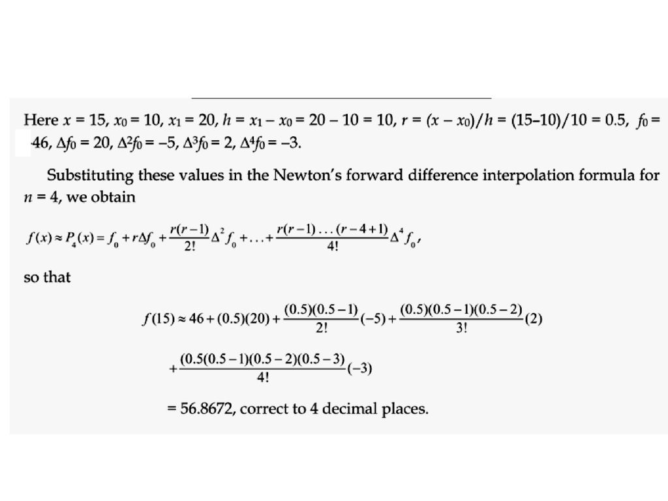

Slide 13
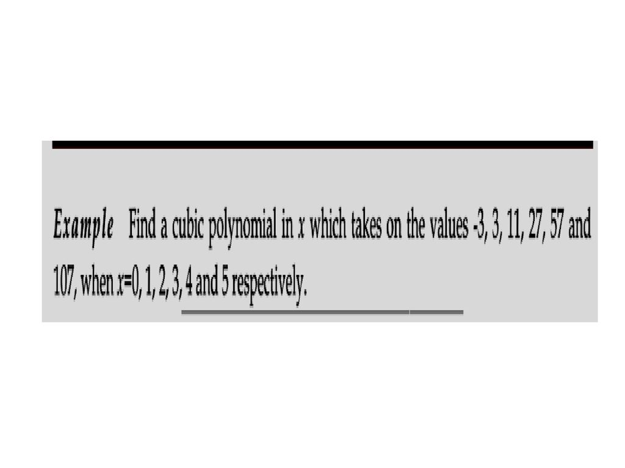

Slide 14
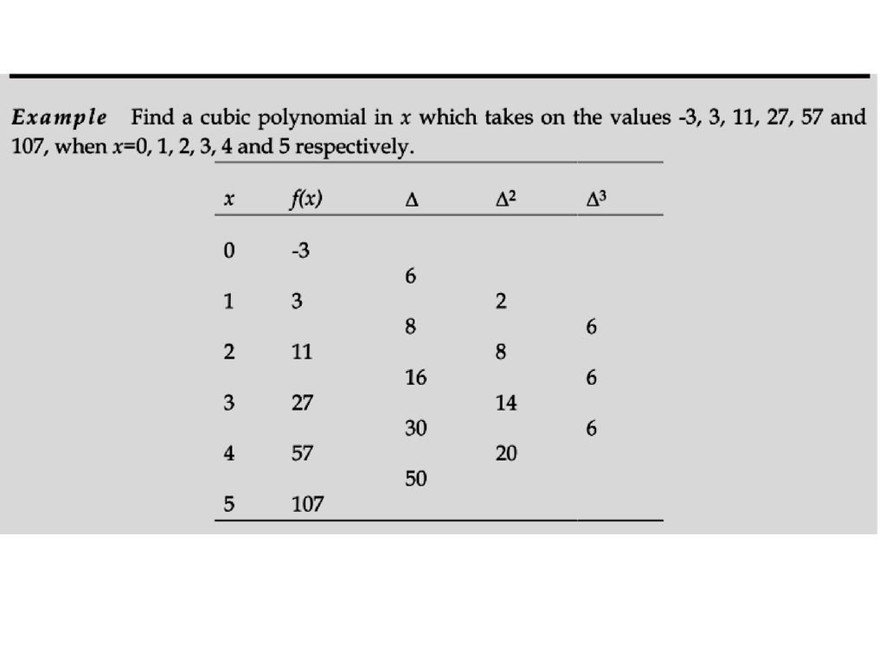

Slide 15
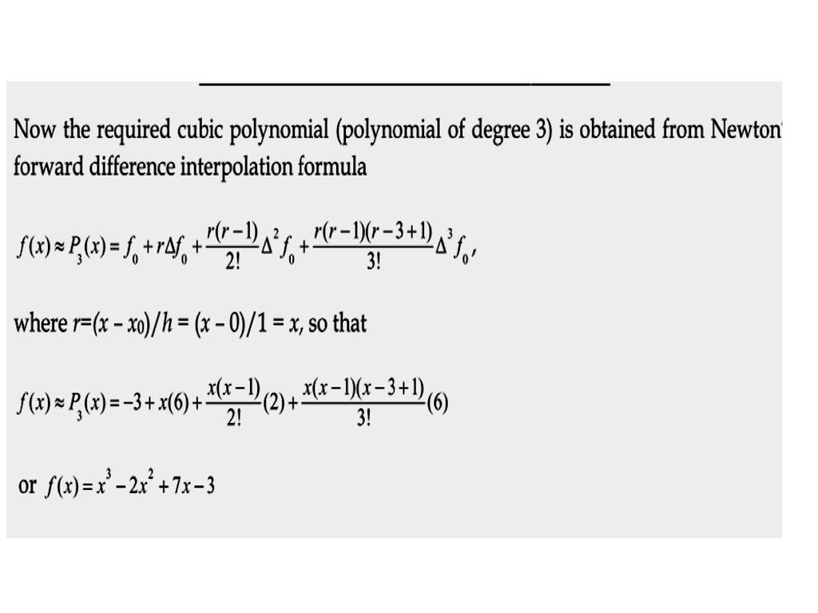

Slide 16
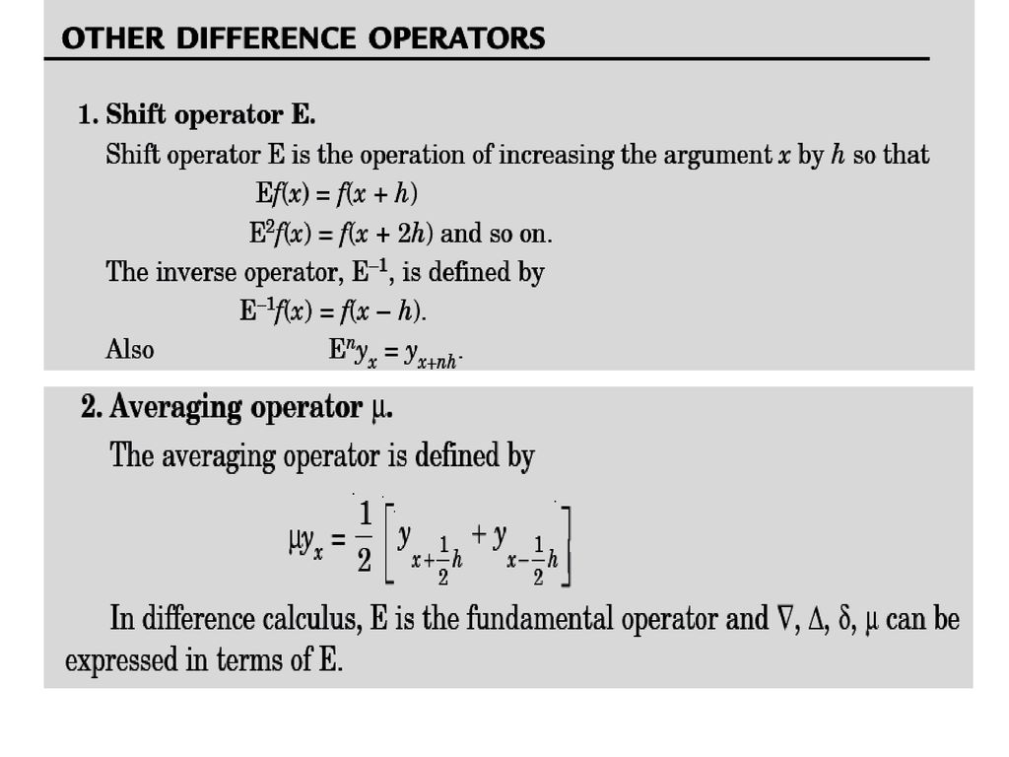

Slide 17
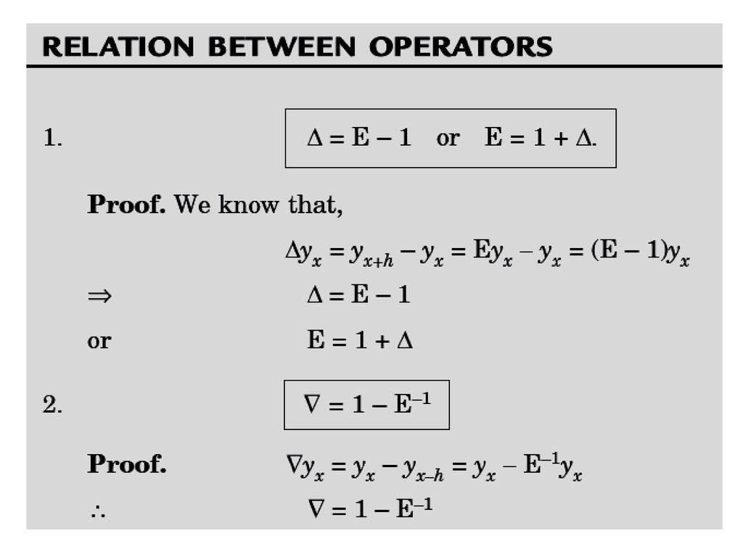

Slide 18
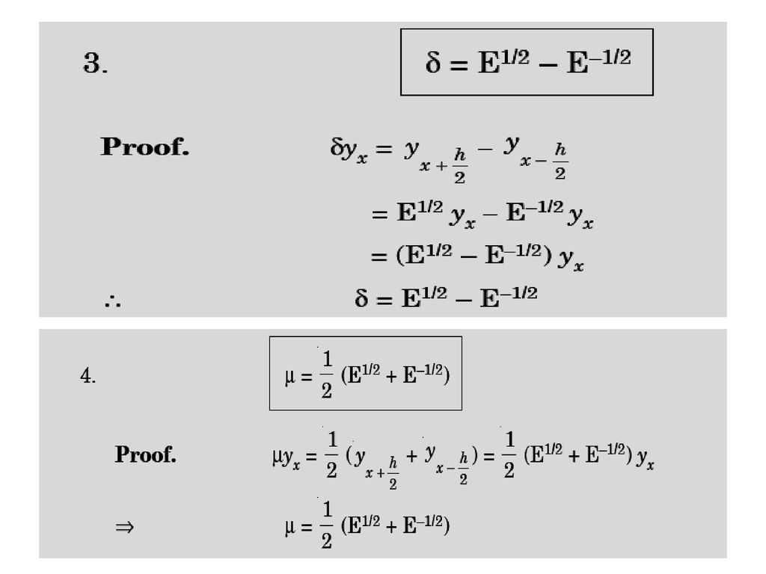

Slide 19
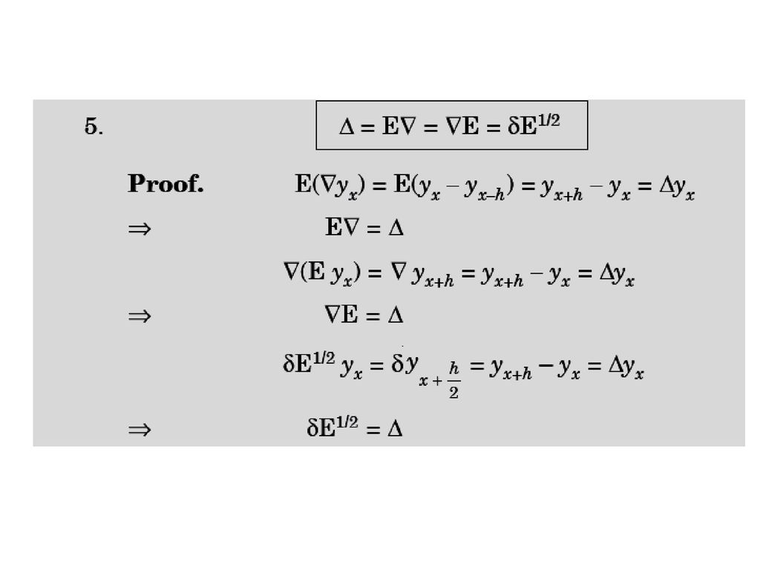

Slide 20
